Slide 1

MedBot
Our personal BayMax.

Slide 2
Problem Statement
Nowadays, it is very difficult to book an appointment with a doctor. Also, it is seen that if you are able to get one, then you end up paying huge amount of bills for just small sessions or advice. Another issue is that everyone needs their personal health trainer as nothing is above your personal health. For that also, we would be paying a lot.
So, to solution for this, we came up with this product idea which can give medical checkups and prescriptions by just use of smartphones. One can get medical treatment at home from medical experts through it. Also, one can order medicines and other fitness equipments at reasonable costs.

Slide 3
What is Medbot?
MedBot is a virtual medical assistant or we can simply a chatbot which analyze users symptoms and predict the ailments.

Slide 4
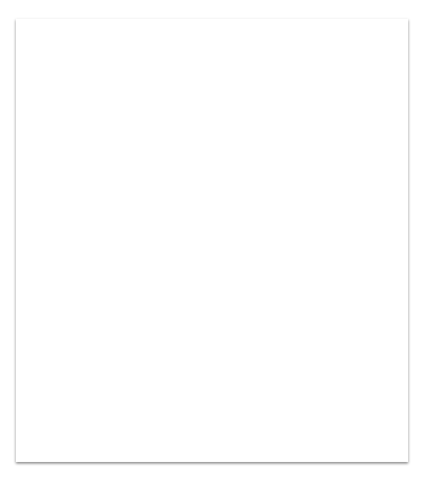

1. Intro
MedBot is currently an idea in which we expect to add the following features:
Virtual Medical Assistant Analyze symptoms and predict ailments.
Online Medical Store Online retailer function so that users can order medicines as well as fitness equipments.
Personalized Medical Report Provide a structured symptoms, predicted diseases and info about it.

Slide 5
About the idea…

Slide 6
A web-app service which can help user in variety of ways.
Firstly, users can have their symptoms diagnosed by just some clicks. The system uses Natural Language to understand and extract useful information from the user response.
Symptoms are checked using a custom database which ensures highly accurate predictions. These predictions can be used by doctors to aid their diagnosis. Their patient on the other hand gets some reliable idea of what might be wrong with them.
However we understand that to get exact diagnosis a doctor’s experience is needed.

Slide 7
2. Execution
Currently, We don’t have an app but we would be working on it in future
Web Web site was made as usual on HTML and frontend was done on Cascading Style Sheets.
Chatbot Chatbot is implemented using concepts of NLP. Currently, Python is used, but in future we might use AIML to make it more accurate.

Slide 8
Design and Implementation Constraints
One of the biggest constraint would be that there would be constant requirement of internet connection like Wi-Fi networks or LAN connections to operate. As the product would be using a big database to analyze medical issues, it might get slow and it might get tough to get quick responses.

Slide 9
Chat with MedBot
In this, user would be chatting with our artificial intelligent medical assistant MedBot and will explain about their issues through which MedBot will try to find out the cure by looking up in our databases. Cures can include medicinal prescription, home remedial, real time doctor consultancy or some exercises.

Slide 10
Online Medical Store
This is an online store where users can browse and purchase medicinal items, gym tools and fitness equipments. This would be very helpful as the software can recommend products itself after knowing the physical and medical condition of the user. So it can be a very great experience for the users while purchasing of health equipments.

Slide 11
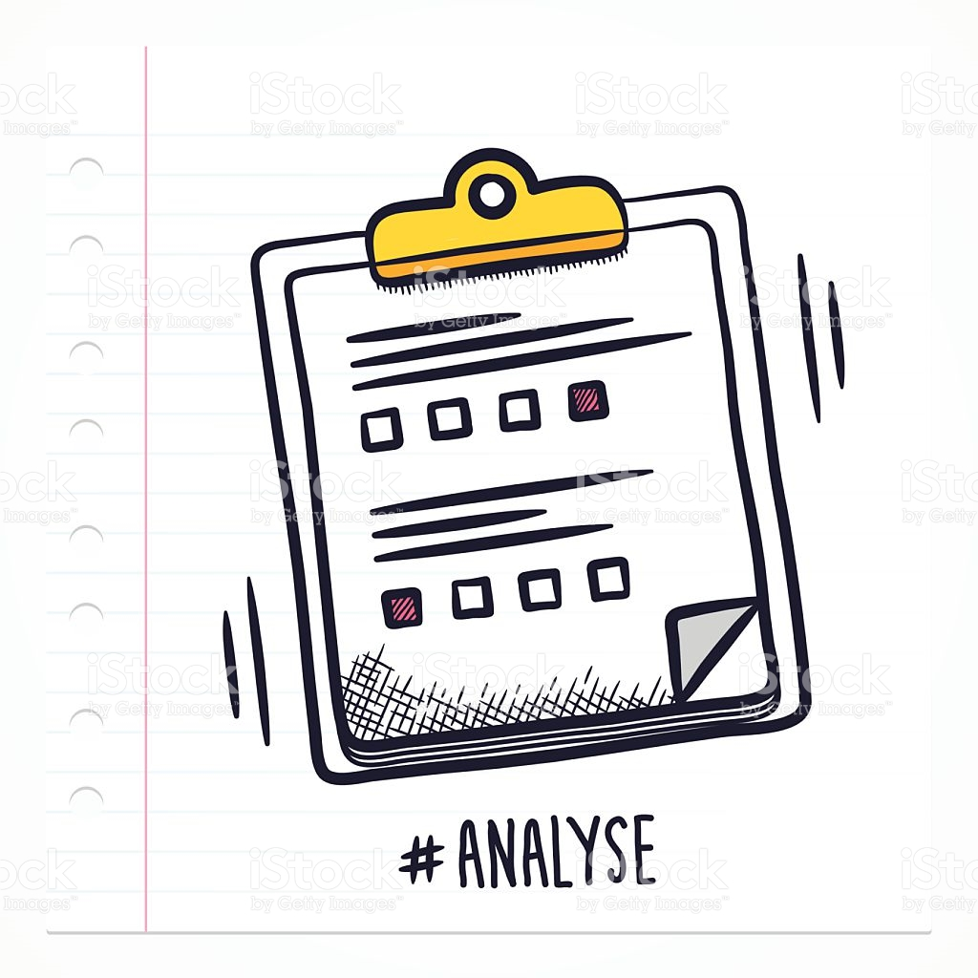
Report Generation:
As we are going to predict the ailment, so we’ll explain the user about 3 of the most probable disease that they might have. The report will include information about disease, severity, and nearby doctors available with respective specialisation.

Slide 12
3. In near future...
In future, We are planning to add an application and a desktop software.
We might also collaborate with some existing online medical retailers to provide everything related to health at one stop.
Also, We will use concepts of computer vision so that users can analyze external injuries with camera and can know about it.
We are also planning to develop a personal trainer which can recommend exercise after calculating daily calories burn and other variables,

Slide 13
4. Conclusion
This product is going to be very helpful to the users as they can easily get medical assistance without paying much. Also, they are getting all this just at their home using smartphone. Also, online medical store would be very helpful as nowadays, it’s very tough to get medicines and other fitness equipments that easily. This product is of great use as it might recommend daily diet chart along with daily exercise schedule. Other than that, on daily basis, one might be able to set daily reminder of medicine and exercise.

Slide 14
Thank You

